Slide 1
First XDJ-XZ mapping for Traktor Pro 3 with JogScreens.
The jog screens require the BOME midi translator.
A free trial is available in https://www.bome.com
IMPORTANT: do NOT set XDJ-XZ in the controller manager.
Put the BOME device there instead!
These slides show the basic configuration for the XDJ-XZ.
For more details, please see the DDJ-1000 specific guide.
For a feature demo, see the videos on:
https://www.youtube.com/user/djestrela2/playlists

Slide 2
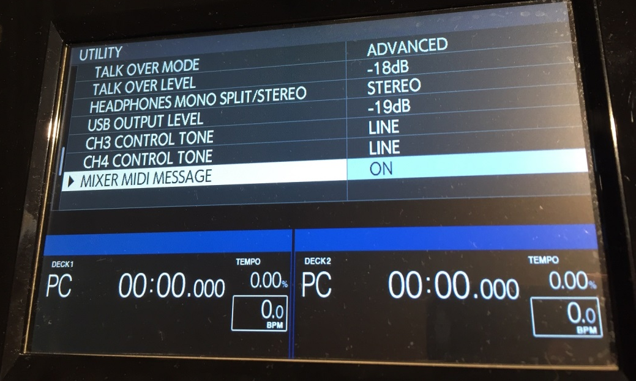
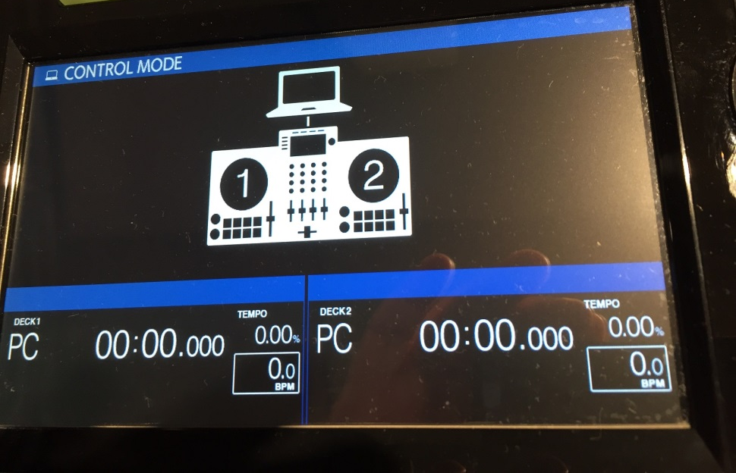
XDJ Config:

Slide 3
Laptop Config:
Please install the XDJ-XZ driver first
Confirm Rekordbox works correctly before going to Traktor

Slide 4
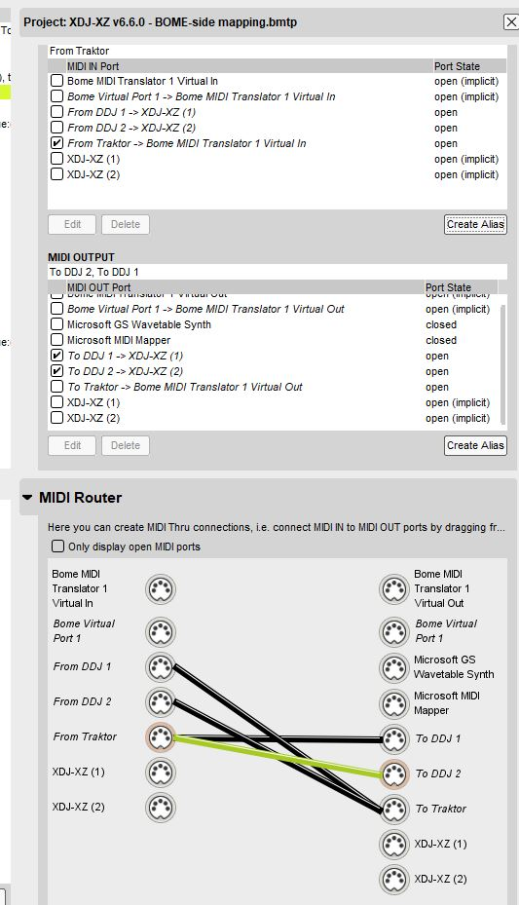
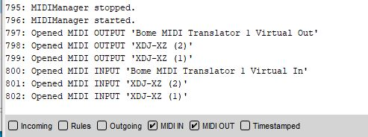
Proper BOME config:
Proper BOME log:

Slide 5
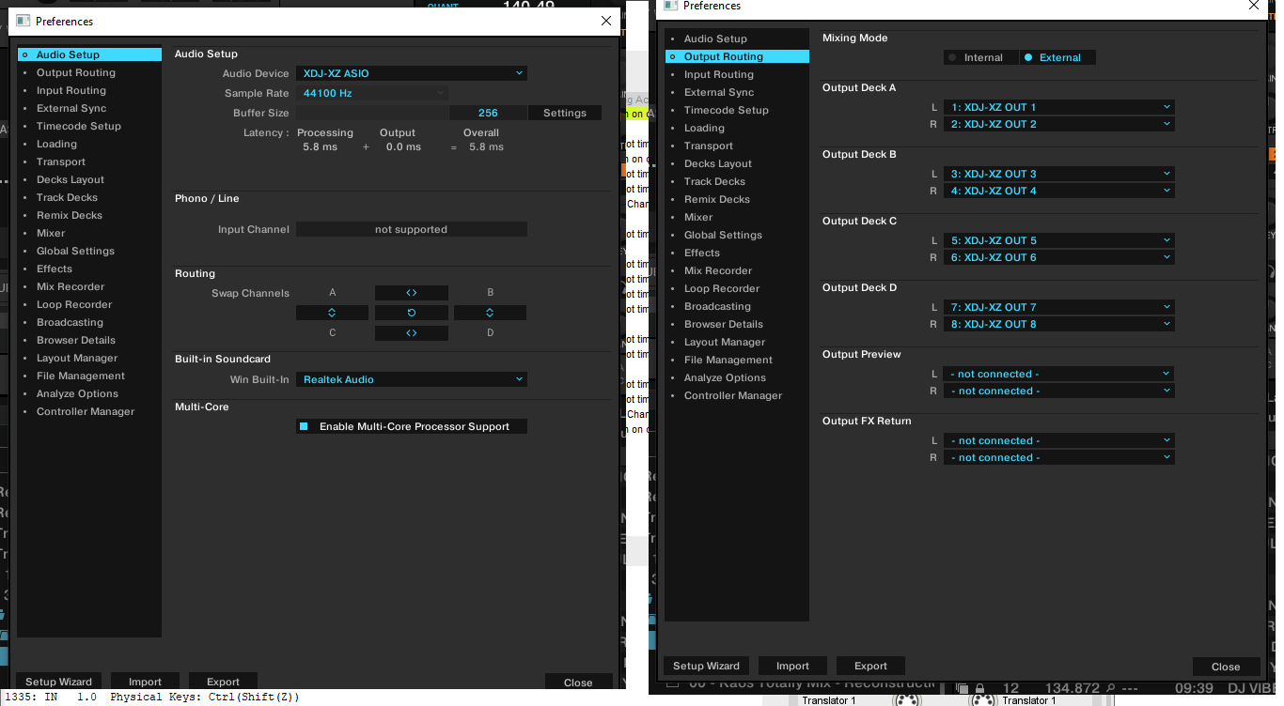
Traktor config:

Slide 6
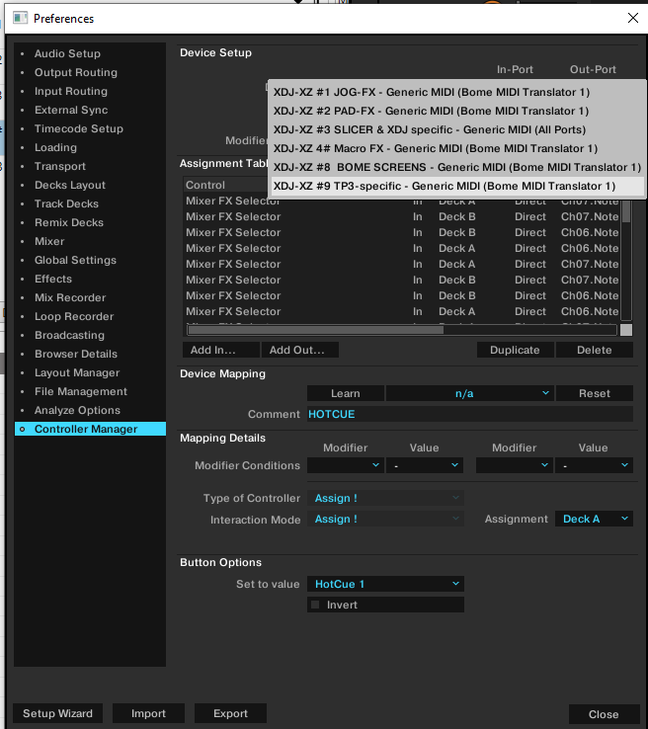
DO NOT put XDJ-XZ here!!!!

